Slide 1
Contactless Digital Parking System
MINI PROJECT ON

Slide 2
CONTENTS
ABSTRACT
FEASIBILITY STUDY
EXISTING SYSTEM
DRAWBACKS OF THE EXISTING SYSTEM
PROPOSED SYSTEM
BENEFITS OF PROPOSED SYSTEM
SCOPE OF THE PROJECT
HARDWARE REQUIREMENTS
SOFTWARE REQUIREMENTS
MODULES AND ITS EXPLANATION
ARCHITECTURAL DIAGRAM
DATAFLOW DIAGRAM (DFD LEVEL 0, DFD LEVEL 1 & DFD LEVEL 2)
USECASE DIAGRAM (OR) CLASS DIAGRAM
DATABASE DESIGN (OR) DETAILS ABOUT DATASETS.
LIST OF MODULES
EXPLANATION ABOUT SOFTWARE MODULES

Slide 3
ABSTRACT
In the current situation parking has become major issue in the urban area with lack of parking facilities. It is very difficult and frustrating to find a parking space in most metropolitan areas, especially during the rush hours to solve these problems the proposed application provide an easy way for reservation of parking slot.
In this application user can view various parking areas and also view whether space is available or not. If the booking space is available then he /she can book it for specific time slot. This will save lot of the time and reduce the parking tension. Person can come pre-planned for the parking space.

Slide 4
FEASIBILITY STUDY
TECHNICAL FEASIBILITY:
To use this application all software are easily available on internet and can be
freely downloaded.
And this application can be freely downloaded. So this application is
technically feasible.
ECONOMICAL FEASIBILITY:
It is very essential because the main goal of the proposed system is to have
economically better result with the increase.
This application is not economically feasible as it can be freely downloaded and
software to use this application is freely available on net.
OPERATIONAL FEASIBILITY:
This application can be operated by all the users across the world.
The illiterate people can also use this application. So this application is operational
feasible.
PROOF OF CONCEPT:
Done By Angular , Spring Boot and

Slide 5
PROOF OF CONCEPT:
Done By Angular , Spring Boot with Mongo DB
Registered > data saved and registered > login up > find area of parking
> View slots>booking slots> message booked key code

Slide 6
EXISTING SYSTEM
We already have many Car Parking management systems
which can provide services for the users
In the Existing System, by using the electrical equipment only
we can find the empty slot by an indication method.
We can only identify the free slot but we can't book the slot
before.

Slide 7
DRAWBACKS OF THE EXISTING SYSTEM
It is difficult to maintain the whole database (images of the parking
space).
Users have to spend 1-2 minutes for booking the slot (only
registered).

Slide 8
PROPOSED SYSTEM
The purpose of this project is to ease the process of parking
through the web application.
In this we mainly concentrate on parking slot in the building
and the user is able to block the slot before entering into the
building.
The web application is designed for client side. It contains only
user friendly options.

Slide 9
BENEFITS OF PROPOSED SYSTEM
A fast and efficient service to the user regarding to the
Searching process is an easy task.
Selecting and booking a slot is also an easy process.
Saves lot of time while searching a free slot in the building and
even may avoid the minor accidents.

Slide 10
SCOPE OF THE PROJECT
A detailed study of the existing system is necessary. The functions of the system, requirements for the users, structure of the current system is made through the system study.
The problems faced in the current system are found and solution pertaining to it is done in the system study

Slide 11
HARDWARE REQUIREMENTS
Pentium Processor
2 GB Ram
50 GB Hard disk

Slide 12
SOFTWARE REQUIREMENTS
Operating System: Windows 8.1 or above
Front End: HTML,CSS
Technology: Angular JS , Spring Boot
Back End: Mongo DB

Slide 13
MODULES AND ITS EXPLANATION
Admin/ Guard Module
User Module
Admin/ Guard Module: Guard will see reserved slots only for the today / current date. Once any vehicle leave from parking lot, guard can vacate that slot. Once guard will vacate slot, it will
become available for new user to book that slot.
User Module: User can make reservation on site after signing up and logging into the site. Once user reserve the parking slot for the desired date.
Once user book the slot for particular date it will become unavailable for
others users. Means no other user can book that slot for that particular
date.

Slide 14
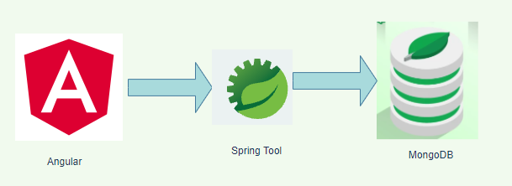
ARCHITECTURAL DIAGRAM
For this project, we are using few technologies to accomplish the work.
The diagram illustrates the list of component used and data flow process from where to where.
Here, we used Angular as front end ,Spring tool as controller layer for integrate database and front-End.

Slide 15
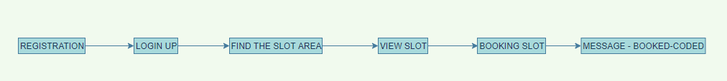
DATA FLOW DIAGRAM
Level 0 DFD (Context level DFD)
Process Flow:
Register page where user details are passed for parking slot booking.
Once the user Registered, he/she can login the page using user name and password.
Once the user logged in it navigate to find the slot area page where it display the
Available slots in view slot page, which we get from database.
In the Booking Slot page, we can select the slot and it will update the database this
Slot is booked. DB sends an success message with that in controller layer we have logical
To generate the code and displays in the UI.

Slide 16
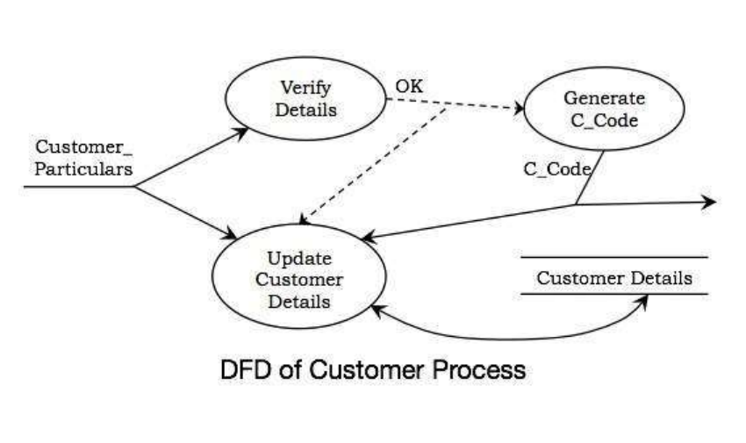
Level-1 DFD - Customer

Slide 17
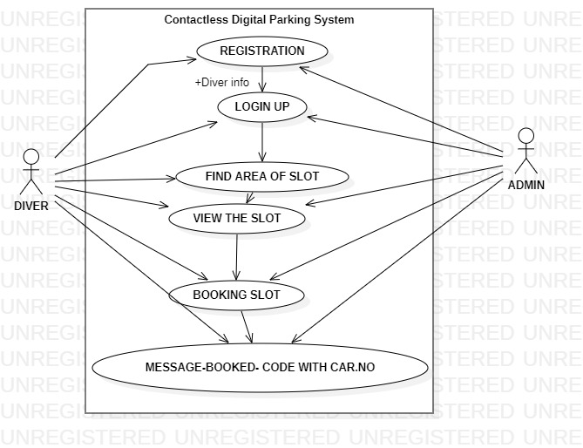
USECASE DIAGRAM

Slide 18
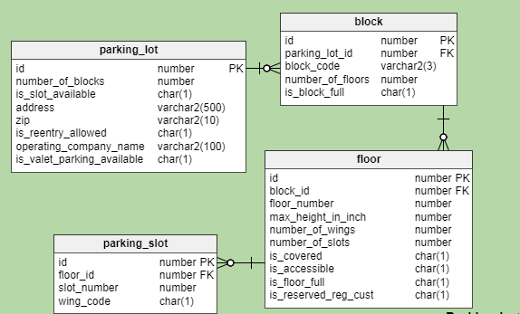
DATABASE DESIGN (OR) DETAILS ABOUT DATASETS.

Slide 19
EXPLANATION ABOUT SOFTWARE MODULES
Here, we used Anugular for front end, spring used to write a controller
and DBA layer to process the data.
For database, we used mongoDb to store the parking slots availability and
Login vaildation for booking slots.

Slide 20
THANK YOU

